Slide 1
Multiple Response Categorical Variable (MRCV)
A test of Independence

Slide 2

MRCV
Surveys that allow respondents to ‘pick any’ or ‘choose all that apply’
E.g:
What waste methods do farmers use? (Lagoon, Pit, Natural Drainage, Holding tank)
What contaminant do they use? (Nitrogen, Phosphrous, Salt)
Data structure : let Ys represent waste methods and Ws contaminant
Traditional methods are not appropriate
Respondents’ responses can be up to the maximum of available options
Tests of independence assumes independence of unique option in each variable
E.g: refer back to the waste methods above, traditional tests of independence assumes independence among lagoon, pit, natural drainage and holding tank.

Slide 3
Data Structure
The structure of the research data

Slide 4

Data Structure
The 2012 National Health Interview Survey
Top 3 alternative therapies:
Respondents can list up to 3 alternative therapies out of 16 choices (e.g: massage, yoga, etc)
Recommendation sources:
Respondents can list up to 4 recommendation sources (e.g: family, doctor, friends, etc)
Data Structure:
Hypothesis:
$H_{0}:$ There is no association between top 3 alternative therapies and recommendation sources
$H_{1}:$ There is association between them

Slide 5
MRCV Tests of Independence
Existing tests for MRCV

Slide 6
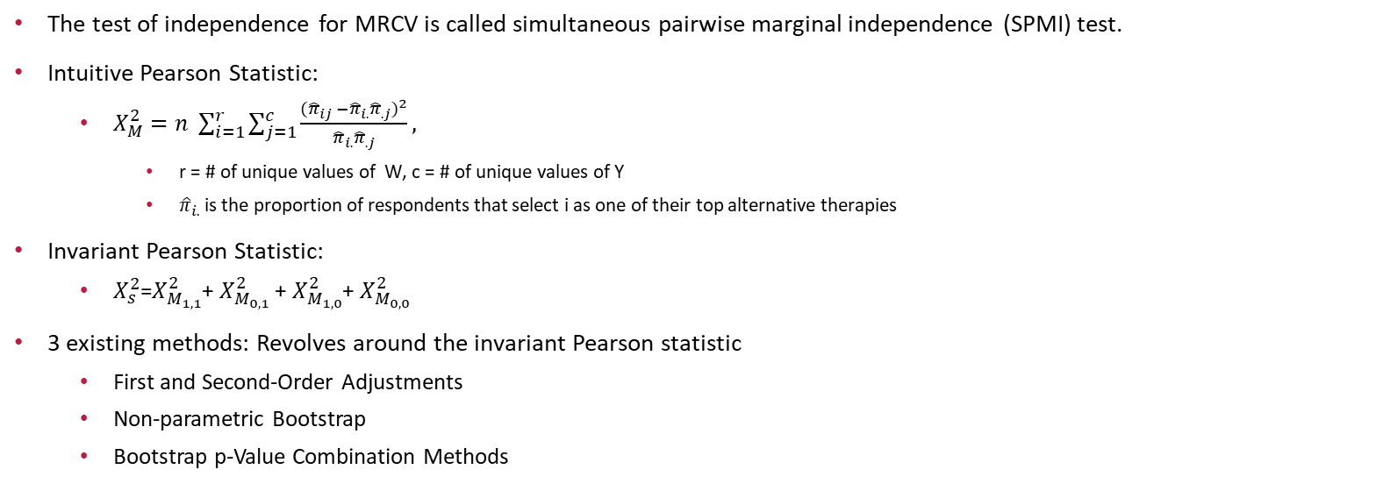
MRCV Tests of Independence
The test of independence for MRCV is called simultaneous pairwise marginal independence (SPMI) test.
Intuitive Pearson Statistic:
$X_{M}^{2}=n \sum_{i=1}^{r}{\sum_{j=1}^{c}{\frac{({{\hat{π}}_{ij} −{\hat{π}}_{i.}{\hat{π}}_{.j})}^{2}}{{\hat{π}}_{i.}{\hat{π}}_{.j}}}},$
r = # of unique values of W, c = # of unique values of Y
${\hat{π}}_{i.}$ is the proportion of respondents that select i as one of their top alternative therapies
Invariant Pearson Statistic:
$X_{s}^{2}$=$X_{M_{1,1}}^{2}$+ $X_{M_{0,1}}^{2}$+ $X_{M_{1,0}}^{2}$+ $X_{M_{0,0}}^{2}$
3 existing methods: Revolves around the invariant Pearson statistic
First and Second-Order Adjustments
Non-parametric Bootstrap
Bootstrap p-Value Combination Methods

Slide 7
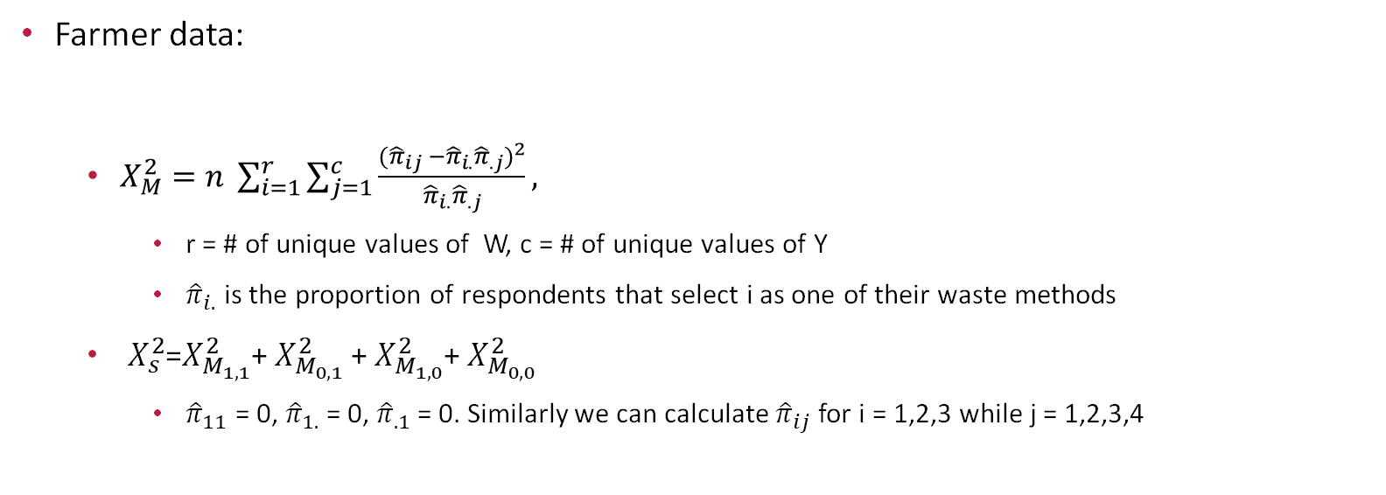
Invariant Pearson Statistic
Farmer data:
$X_{M}^{2}=n \sum_{i=1}^{r}{\sum_{j=1}^{c}{\frac{({{\hat{π}}_{ij} −{\hat{π}}_{i.}{\hat{π}}_{.j})}^{2}}{{\hat{π}}_{i.}{\hat{π}}_{.j}}}},$
r = # of unique values of W, c = # of unique values of Y
${\hat{π}}_{i.}$ is the proportion of respondents that select i as one of their waste methods
$X_{s}^{2}$=$X_{M_{1,1}}^{2}$+ $X_{M_{0,1}}^{2}$+ $X_{M_{1,0}}^{2}$+ $X_{M_{0,0}}^{2}$
${\hat{π}}_{11}$ = 0, ${\hat{π}}_{1.}$= 0, ${\hat{π}}_{.1}$= 0. Similarly we can calculate ${\hat{π}}_{ij}$ for i = 1,2,3 while j = 1,2,3,4

Slide 8

First and Second-Order ADjustments
Applicable to situation without simple random sampling
Modify the Pearson statistic to have the same asymptotic expectation and variance as a $χ^{2}$ random variable

Slide 9

Non-parametric bootstrap
Ws and Ys are independently resampled with replacement from the data set.
P-value is calculated $B^{−1}\sum_{b}{I(X_{S,b}^{2∗} ≥ }$ $X_{S}^{2})$,
$X_{S,b}^{2∗}$is the bth sample invariant Pearson statistic
B is the number of resamples taken

Slide 10
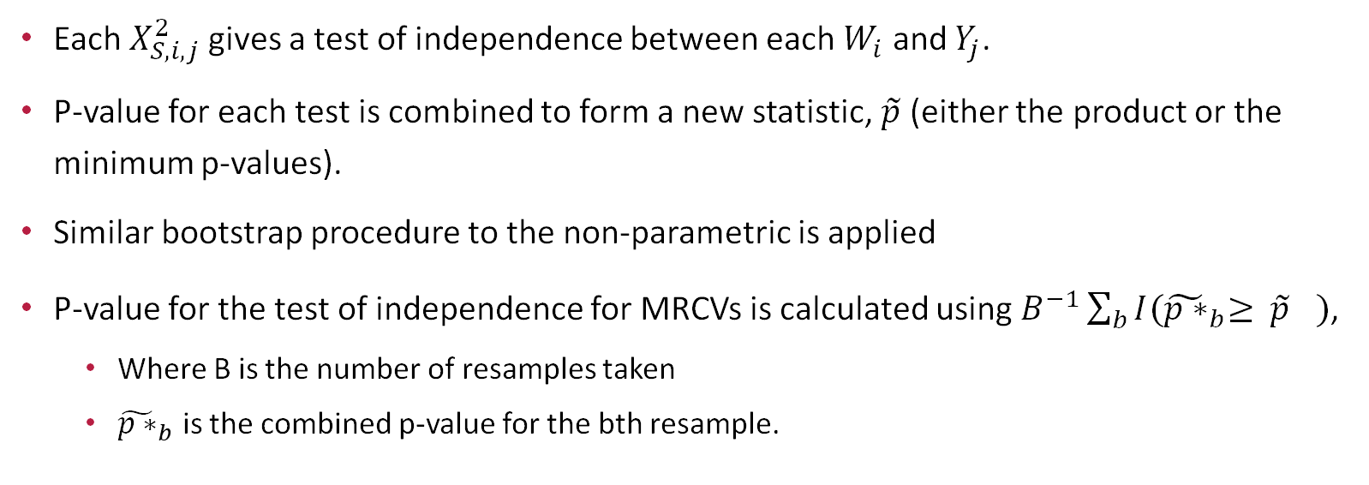
Bootstrap p-Value Combination Methods
Each $X_{S,i,j}^{2}$gives a test of independence between each $W_{i}$ and $Y_{j}$.
P-value for each test is combined to form a new statistic, $\tilde{p}$ (either the product or the minimum p-values).
Similar bootstrap procedure to the non-parametric is applied
P-value for the test of independence for MRCVs is calculated using $B^{−1}\sum_{b}{I({\tilde{p∗}}_{b}≥ }$ ${\tilde{p}}_{}^{})$,
Where B is the number of resamples taken
${\tilde{p∗}}_{b}$ is the combined p-value for the bth resample.

Slide 11
MRCV Tests of Independence
Existing methods are not appropriate for the research data
The research data only contains information when a respondent gives information about their choice of alternative therapy.
E.g: A respondent chooses massage as a choice of therapy, they can be influenced by their friends, family, doctor, other or not. However, if they do not choose massage as their choice of therapy, no information about the recommendation sources was provided.
Therefore, the invariant Pearson statistic is not appropriate.
We propose a modified Pearson statistic.

Slide 12
Modified Pearson Statistic
Proposed methods for association test

Slide 13
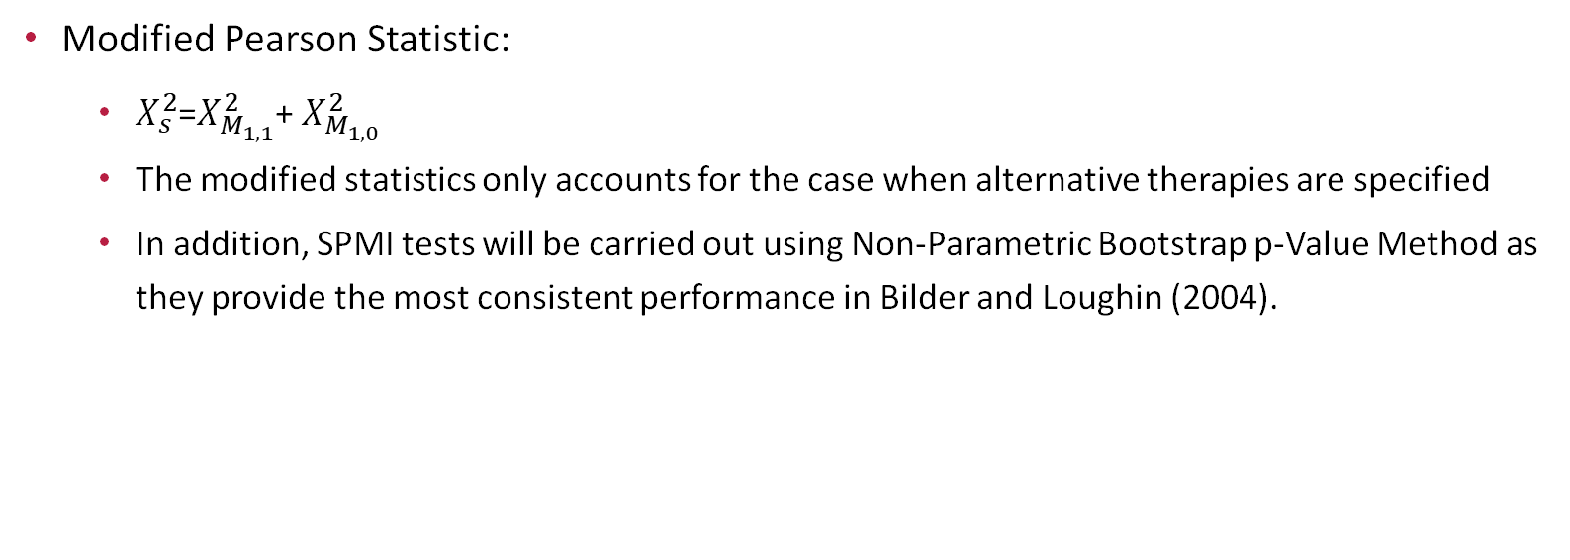
Modified Pearson Statistic
Modified Pearson Statistic:
$X_{s}^{2}$=$X_{M_{1,1}}^{2}$+ $X_{M_{1,0}}^{2}$
The modified statistics only accounts for the case when alternative therapies are specified
In addition, SPMI tests will be carried out using Non-Parametric Bootstrap p-Value Method as they provide the most consistent performance in Bilder and Loughin (2004).

Slide 14
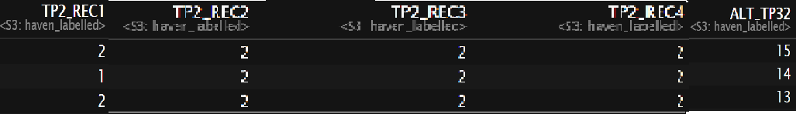

Modified Pearson Statistic
Research Data:
$X_{M}^{2}=n \sum_{i=1}^{r}{\sum_{j=1}^{c}{\frac{({{\hat{π}}_{ij} −{\hat{π}}_{i.}{\hat{π}}_{.j})}^{2}}{{\hat{π}}_{i.}{\hat{π}}_{.j}}}},$
$X_{s}^{2}$=$X_{M_{1,1}}^{2}$+ $X_{M_{1,0}}^{2}$
${\hat{π}}_{22}$ = 1/3, ${\hat{π}}_{2.}$= 1/3, ${\hat{π}}_{.2}$= 5/(2*3)=5/6.

Slide 15
Simulation experiments
Type I Error and Power experiments on simulated data

Slide 16
Simulation Setting
We performed SPMI tests on two randomly selected Ws and Ys
Type I error:
We perform SPMI tests for two random values of each variable, W = (W1, W2) and Y = (Y1, Y2). To simulate data under SPMI we set the odds ratio OR = 2 (denoting weak dependence) with P(W) = (0.4, 0.6) and P(Y) = (0.2, 0.3).
Power:
Similar to Type I Error setting, SPMI tests were performed for both W and Y randomly selected. P(W) = (0.4, 0.6) stays the same. However, P(Y) = (0.2, 0.3) when W1 = 1 and P(Y) = (0.2, 0.8) when W2 = 1. We’ll refer to this experiment as Power setting 1.
Another power test is carried out with P(Y) = (0.2, 0.3) when W1 = 1 and P(Y) = (0.2, 0.5) when W2 = 1. This setting will be referred as Power setting 2 .
Simulated Data:
500 simulated datasets were created for each experiment using the simulation setting specified above. The procedure to generate each dataset follows the Gange algorithm (1995).

Slide 17
Type I Error Results
As previously mentioned, Non-parametric Bootstrap Method was selected due to its stability. 1999 bootstrapped datasets were generated for each of the 500 simulated datasets.
The results show that Type I error is 0. We fail to reject the null hypothesis for all the simulated datasets.

Slide 18
Power
Similar to Type I error bootstrapping procedure, 1994 bootstrapped datasets were generated for each dataset of the 500 simulated datasets.
For Power setting 1, the power is 1.0. We reject the null hypothesis all the time.
For Power setting 2, the power is 0.412. We reject the null hypothesis 41.2% of the time. This result is expected as the marginal probability settings for Power setting 1is higher than setting 2, denoting stronger association.

Slide 19
Real data analysis
Result Report

Slide 20

Are Top 3 alternative choices and recommendation sources independent?
$H_{0}:$ There is no association between top 3 alternative therapies and recommendation sources
$H_{1}:$ There is association between them
Similarly to the bootstrapping procedure in the simulated experiments, 1999 bootstrapped datasets were generated from the research data. The p-value is 0. We reject the null hypothesis at the 0.05 significant level.

Slide 21
Conclusion
Traditional tests of independence are not appropriate for MRCVs
Existing SPMI tests are not applicable to the research data
Proposed Modified Pearson statistics produce relatively good Type I error and power for simulated data.
The test of independence for the two interested variables show they are not independent.

Slide 22
References
Bilder, Christopher R., and Thomas M. Loughin. “Testing for Marginal Independence between Two Categorical Variables with Multiple Responses.” Biometrics, vol. 60, no. 1, 2004, pp. 241–248. JSTOR, www.jstor.org/stable/3695573. Accessed 22 June 2020.
Gange, Stephen J. “Generating Multivariate Categorical Variates Using the Iterative Proportional Fitting Algorithm.” The American Statistician, vol. 49, no. 2, 1995, pp. 134–138. JSTOR, www.jstor.org/stable/2684626. Accessed 22 June 2020.
Nataliea., Koziol, and Bilder Christopherr. “MRCV: A Package for Analyzing Categorical Variables with Multiple Response Options.” The R Journal, vol. 6, no. 1, 2014, p. 144., doi:10.32614/rj-2014-014.

